Slide 1
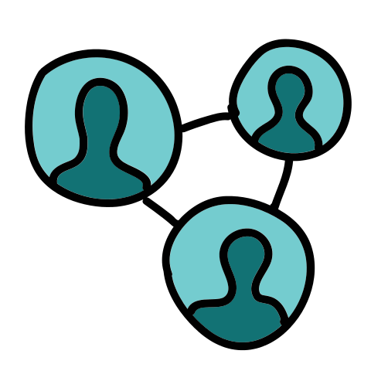
Spotting Suspicious Academic Citations Using Self-Learning Graph Transformers
Capstone Project Phase B – 61999 Project number:
24-1-R-16
Presenters:
Almog Madar
Mor Ben Haim
Supervised by : Prof. Zeev Volkovich.
Advised by: Dr. Renata Avros.

Slide 2
Manipulated citations
Manipulated citations, a grave threat to academic integrity, involve the intentional inclusion of references in academic works for biased advantages, rather than for their genuine academic merit.
These citations do not support the author's arguments or provide relevant background information; their primary purpose is to inflate the citation count of the author artificially
As mentioned in the literature, more than 66% of references in a paper are unstable.
This finding provides further evidence of the widespread presence of dubious citations.

Slide 3
Publication
The results obtained in the project are published in Spotting Suspicious Academic Citations Using Self-Learning Graph Transformers .
Renata Avros , Mor Ben Haim , Almog Madar , Elena Ravve and Zeev Volkovich Software Engineering Department , Braude College of Engineering, Karmiel 2161002 , Israel .
Mathematics 2024, 12(6), 814 https://doi.org/10.3390/math12060814 .

Slide 4
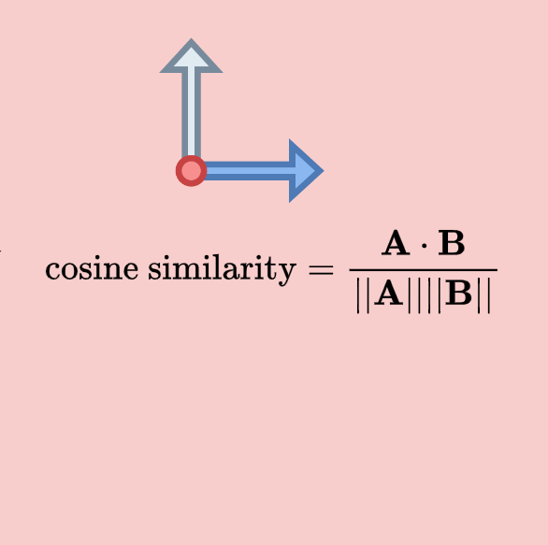
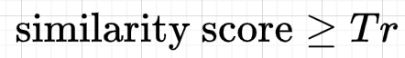
Main Idea
The main idea is to use graph masking for checking of the edges reability
Part of the graph is masked and the rest of the network is used as the study material for a neural network constructed to provide link prediction within the masked part.
Edges with cosine scores greater or equal to the threshold (Tr) will be considered as real (stable) edges of the citation network.
Otherwise, the edge is suspected to be manipulated.
Notes:
Edge Based Cosine Scores :
Compare the prediction scores with the threshold (Tr)
Edges with scores greater or equal to the threshold (Tr) are classified as real edges. These are likely valid connections in the graph.
Edges with scores less than the threshold (Tr) are classified as manipulated edges. These connections are suspect and might be unreliable.

Slide 5
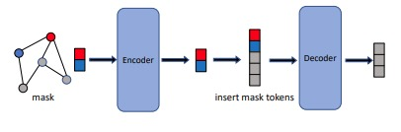


Model Training
Graph Masked Autoencoders (GMAEs) are a type of self-supervised, transformer-based model designed for learning graph representations.
The key features of GMAEs include a masking mechanism and an asymmetric encoder-decoder design.
The masking mechanism in GMAEs involves taking partially masked graphs as input. The purpose of this is to reconstruct the features of the masked nodes, which is a form of self-supervised learning.
This means that the model is trained to predict or fill in the missing parts of the input data, which can help it learn useful features and representations of the data.
Mask_predicted
5 | 4 | 3
$$MSE(mask_{target},mask_{predicted})$$
$$N⋅x$$
$$M⋅x$$
5 | 4 | 3
Mask_target
Notes:
If panel, ask about hyper-pram:
Cora:
Batch size == 32 , Mask Ratio == 0.8 , n_encoder_layers == 4 , n_decoder_layers == 2 .
Citeseer:
Batch size == 64 , Mask Ratio == 0.7 , n_encoder_layers == 8 , n_decoder_layers == 2 .

Slide 6
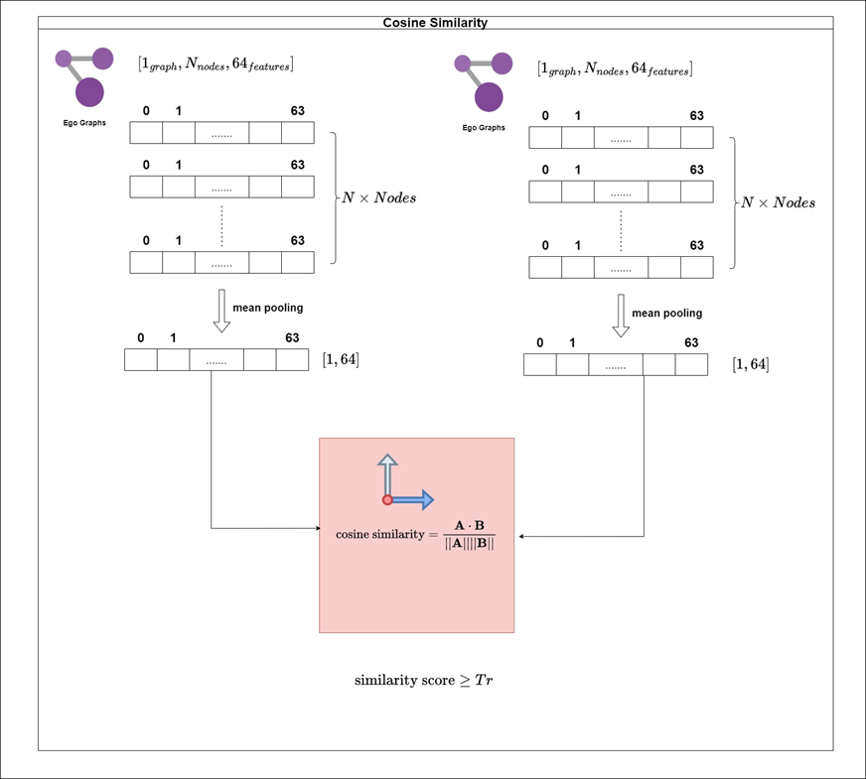








Reconstruct masked connections
After training the deep network on partial data (e.g., 70% nodes). The aim is to reconstruct the omitted masked nodes (e.g. , 30%) by identifying potential links with similarity scores that meet or exceed the threshold (Tr).
Does the connection meet
the threshold(Tr) condition ?
Recover Sub Citation Network
(Based on 30% nodes)
Notes:
After training the encoder, the model performs similarity analysis on unseen vectors representing ego-graphs from the testing set.
Unseen Testing Set Vectors: We introduce new, unseen vectors representing ego-graphs from the testing set. The encoder did not encounter these vectors during training.
Learnable Encoder Application: These unseen testing set vectors are fed through the trained encoder. Recall that the encoder incorporates learnable tokens to capture the overall graph structure, allowing it to generalize to unseen data.
Essentially, this process evaluates the encoder's ability to generalize to unseen data by analyzing the similarity between ego-graphs in the testing set based on their encoded representations and cosine similarity scores.

Slide 7
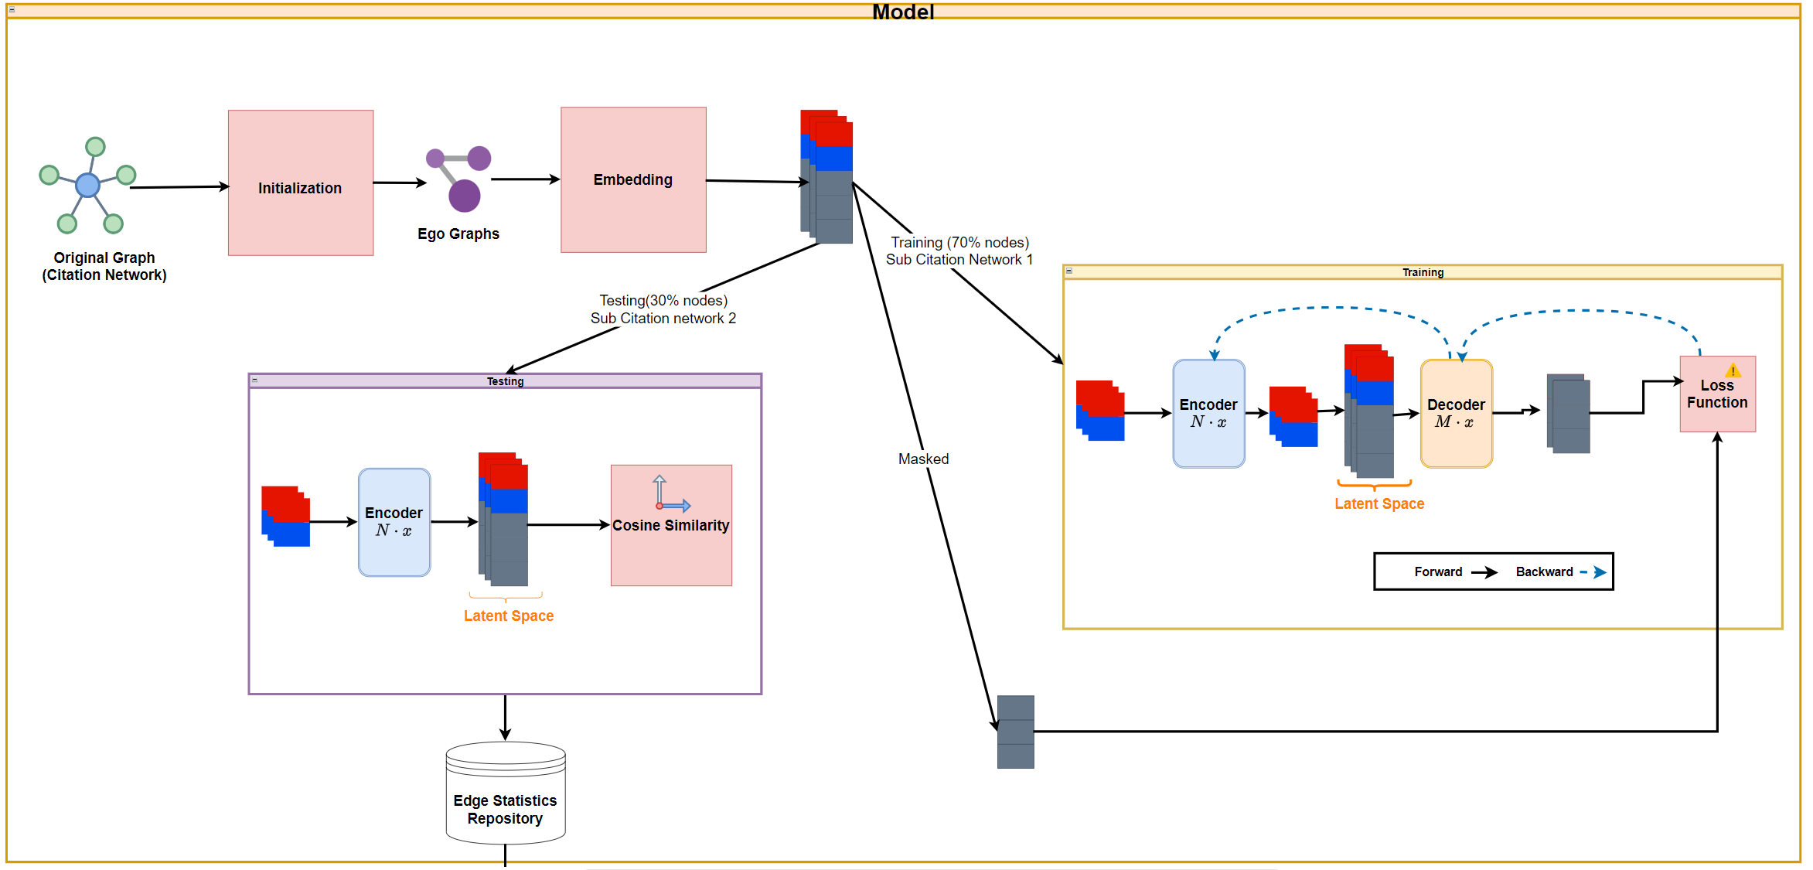
Model Diagram
Notes:
Code Based Algorithm
Load Graph Data Load a graph G = (V, E), Plaintoid Dataset.
Iterate for N times - 50 independent experiments.
Split Graph (citation network) into training and testing sets.
Training Phase (Sub citation based on 70% nodes).
Testing\Reconstruction Phase (Sub citation based 30% nodes).
Analysis results with histogram and Statistics. *model is trained to predict or fill in the missing parts of the input data
*reconstruct the omitted masked connection (Potential links).

Slide 8
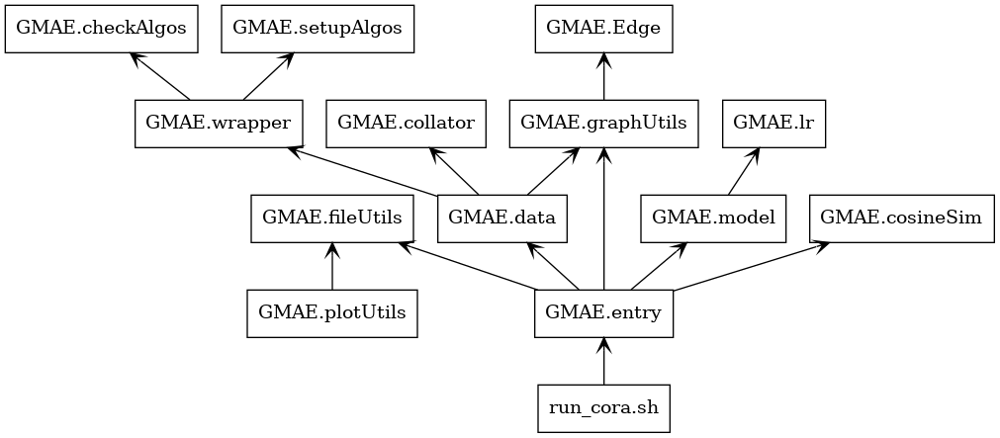
Software Pack Diagram
Notes:
*Bash-Script = designed to setup & run our entry (machine learning pipeline) , with the experiments using specified parameters .
*Entry = Main Machine Learning Pipeline .
*fileUtils = File Operations and Data Persistence , Saving and loading data using pickle and creating various text files.
*Data = Handling graph datasets, preprocessing, and providing data loaders for training, validation in a machine learning context.
*Wrapper = GMAE_graph positional encoding preparation
[ x, y, adj, attn_bias, spatial_pos (Floyd) , in_degree, out_degree , node_id].
*Collator = Batch Collation and Padding processing (Creation of Batch’s for training and testing process)
[ min_node_num , attn_bias , spatial_pos , in_degree , out_degree , x , y , nodeID].
*GraphUtils = Building a dictionary of edges and preparing data for training and testing in graph-based machine learning tasks.
[buildDictOfAllEdges , Prepare_data]
*Model = Define a graph-based masked autoencoder model (GMAE) using PyTorch Lightning.
*CosineSim = Handle Edge Reconstruction (Restoration) Using Cosine Similarity.
[createGmaeVectors, calc_edges_restore]
*LR = Custom Learning Rate Schedulers , PolynomialDecayLR, which adjusts the learning rate according to a polynomial decay.

Slide 9
Experiments Results
Notes:
The recovering edge distributions for the CORA disturbed dataset L2 = 5

Slide 10
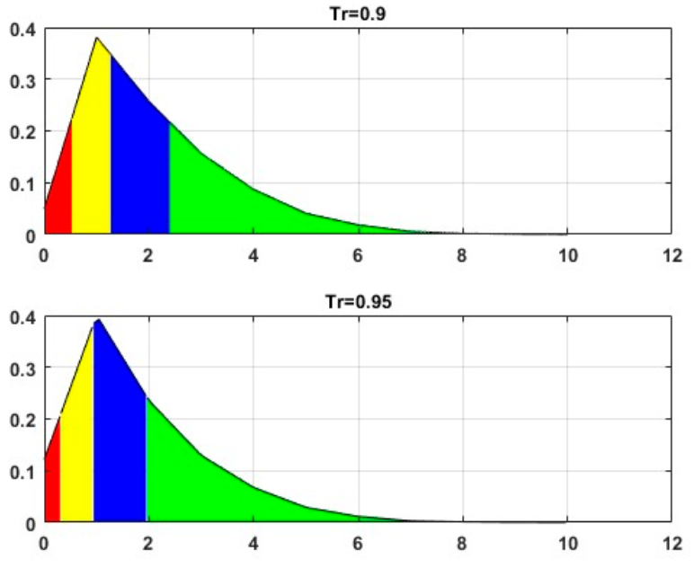
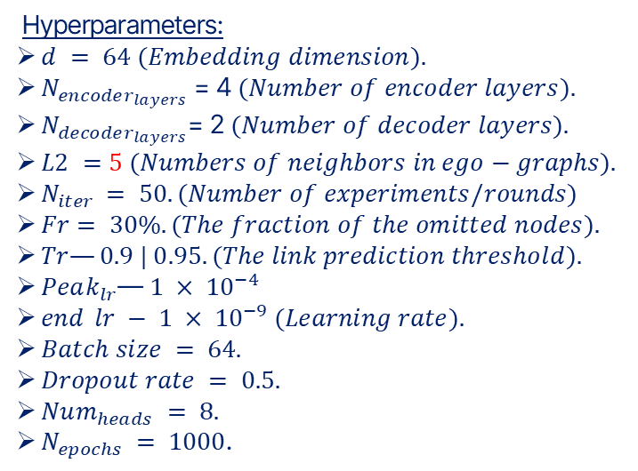
Cora Dataset , L2=5
Hyperparameters:
$d = 64 (Embedding dimension).$
$N_{encoder_{layers}}$= 4 $(Number of encoder layers).$
$N_{decoder_{layers}}$= 2 $(Number of decoder layers).$
$L2 =5 (Numbers of neighbors in ego−graphs).$
$N_{iter }= 50. (Number of experiments/rounds)$
$Fr= 30\%. (The fraction of the omitted nodes).$
$Tr—0.9 | 0.95. (The link prediction threshold).$
$Peak_{lr}$—$1 × {10}^{−4}$
$end_lr − 1 × {10}^{−9} (Learning rate).$
$Batch size = 64.$
$Dropout rate = 0.5.$
$Num_{heads} = 8.$
$N_{epochs} = 1000$.
Notes:
The recovering edge distributions for the CORA disturbed dataset L2 = 5 .

Slide 11
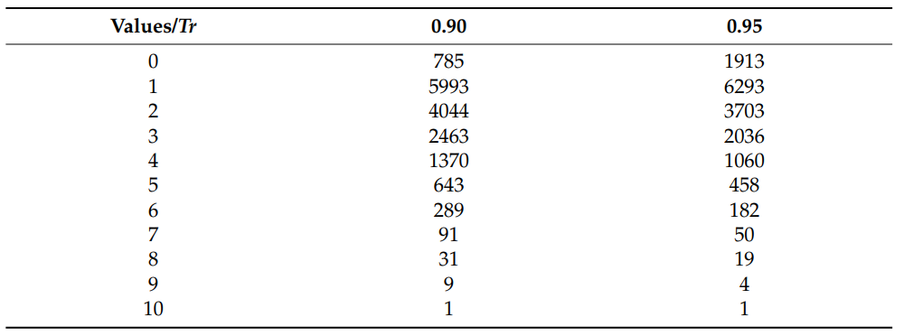
Cora Dataset , L2=5
Notes:
The recovering edge distributions for the CORA disturbed dataset L2 = 5 .
over 66% from references in a paper unnecessary , which mean could be suspected as manipulated .

Slide 12
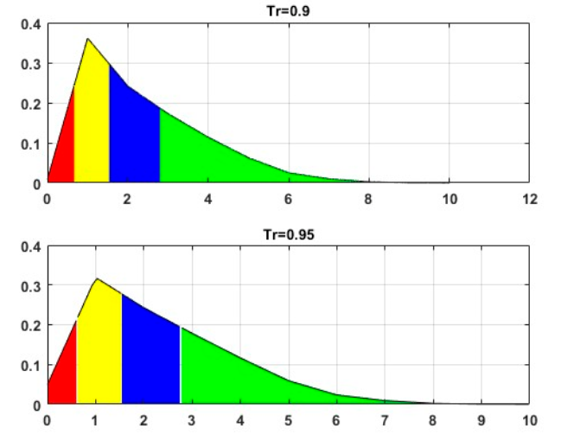
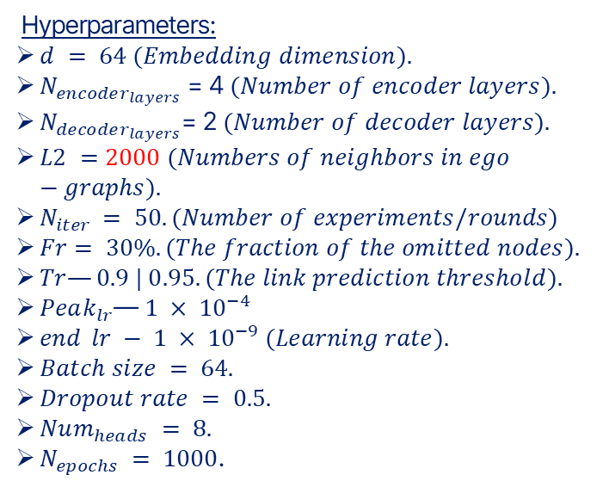
Cora Dataset , L2=2000
Hyperparameters:
$d = 64 (Embedding dimension).$
$N_{encoder_{layers}}$= 4 $(Number of encoder layers).$
$N_{decoder_{layers}}$= 2 $(Number of decoder layers).$
$L2 =2000 (Numbers of neighbors in ego−graphs).$
$N_{iter }= 50. (Number of experiments/rounds)$
$Fr= 30\%. (The fraction of the omitted nodes).$
$Tr—0.9 | 0.95. (The link prediction threshold).$
$Peak_{lr}$—$1 × {10}^{−4}$
$end_lr − 1 × {10}^{−9} (Learning rate).$
$Batch size = 64.$
$Dropout rate = 0.5.$
$Num_{heads} = 8.$
$N_{epochs} = 1000$.
Notes:
The recovering edge distributions for the CORA dataset for L2 = 2000

Slide 13
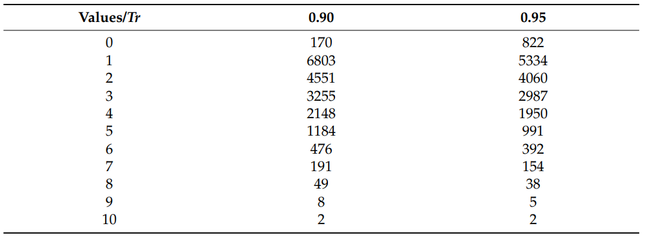
Cora Dataset , L2=2000
Notes:
The recovering edge distributions for the CORA dataset for L2 = 2000

Slide 14
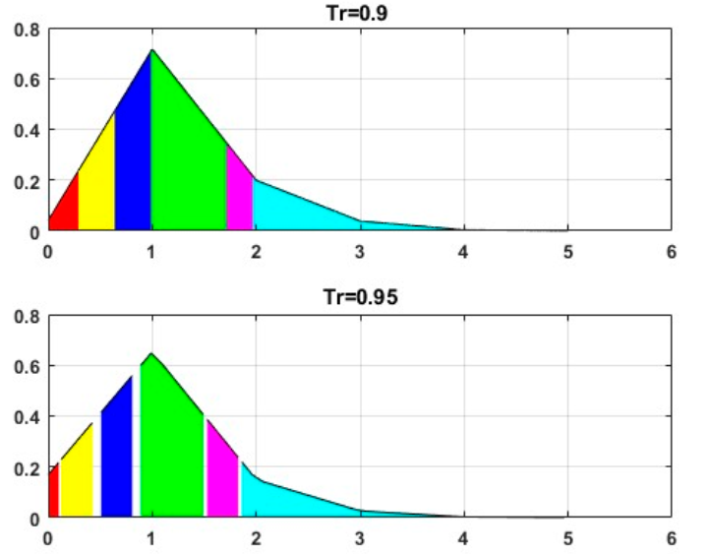
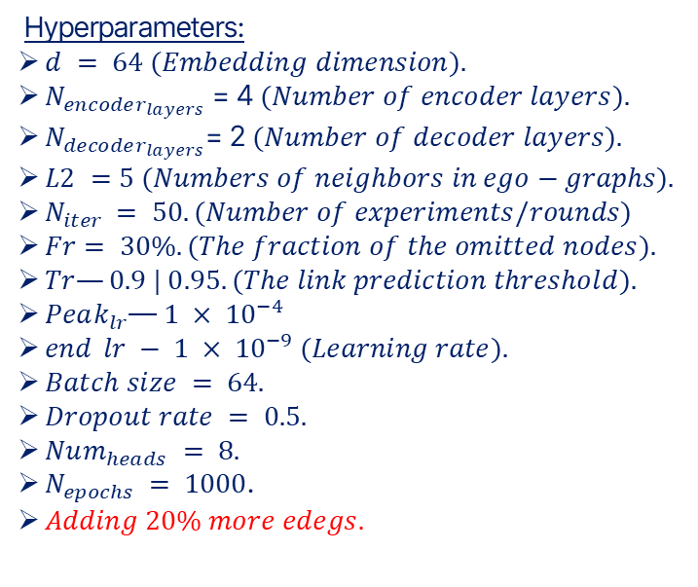
Noise Cora Dataset , L2=5
Hyperparameters:
$d = 64 (Embedding dimension).$
$N_{encoder_{layers}}$= 4 $(Number of encoder layers).$
$N_{decoder_{layers}}$= 2 $(Number of decoder layers).$
$L2 =5 (Numbers of neighbors in ego−graphs).$
$N_{iter }= 50. (Number of experiments/rounds)$
$Fr= 30\%. (The fraction of the omitted nodes).$
$Tr—0.9 | 0.95. (The link prediction threshold).$
$Peak_{lr}$—$1 × {10}^{−4}$
$end_lr − 1 × {10}^{−9} (Learning rate).$
$Batch size = 64.$
$Dropout rate = 0.5.$
$Num_{heads} = 8.$
$N_{epochs} = 1000$.
$Adding 20\% more edegs.$
Notes:
This involves introducing artificial randomness by adding 20% more edges to the dataset.
/////////////////////////////////////////////////////////////////////////////////////////////////////////////////

Slide 15
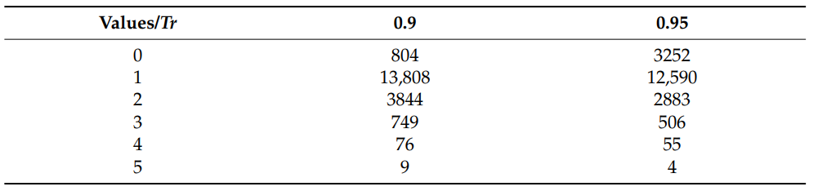
Noise Cora Dataset , L2=5
Notes:
This involves introducing artificial randomness by adding 20% more edges to the dataset.

Slide 16
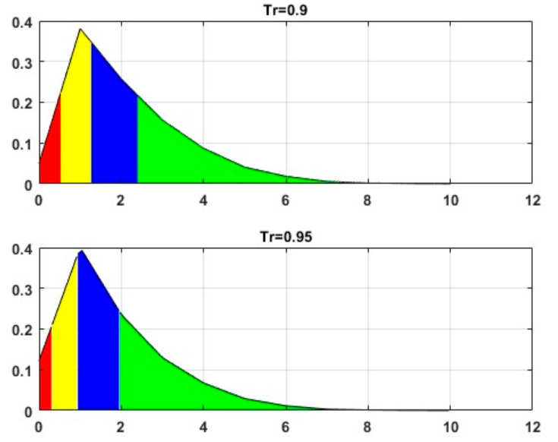
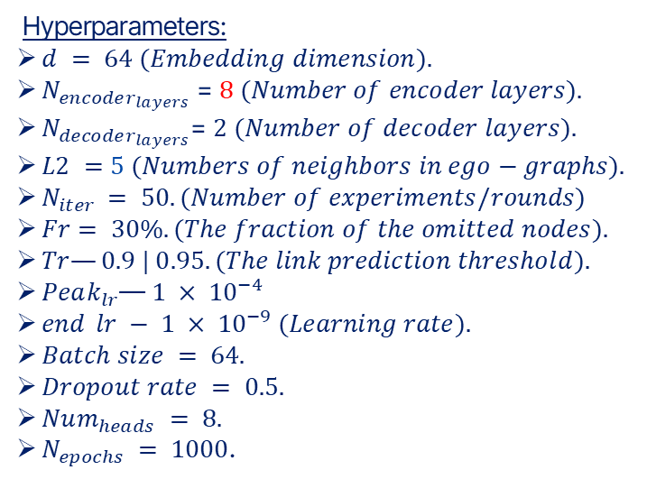
Citeseer Dataset , L2=5
Hyperparameters:
$d = 64 (Embedding dimension).$
$N_{encoder_{layers}}$= $8$ $(Number of encoder layers).$
$N_{decoder_{layers}}$= $2$ $(Number of decoder layers).$
$L2 =5 (Numbers of neighbors in ego−graphs).$
$N_{iter }= 50. (Number of experiments/rounds)$
$Fr= 30\%. (The fraction of the omitted nodes).$
$Tr—0.9 | 0.95. (The link prediction threshold).$
$Peak_{lr}$—$1 × {10}^{−4}$
$end_lr − 1 × {10}^{−9} (Learning rate).$
$Batch size = 64.$
$Dropout rate = 0.5.$
$Num_{heads} = 8.$
$N_{epochs} = 1000$.
Notes:
The recovering edge distributions for the Citeseer dataset for L2 = 2000 .
Check the system core internal structure.
Around 75% of the total edges prove sensitive to the distortion procedure.
The instability of these citation with their heightened sensitivity to data modifications, sets them apart from the system core internal structure.
Therefore, most of the citations in the group are potentially suspected to be manipulated.

Slide 17
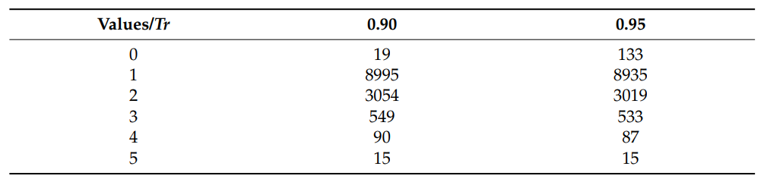
Citeseer Dataset , L2=5
Notes:
The recovering edge distributions for the Citeseer dataset for L2 = 2000

Slide 18
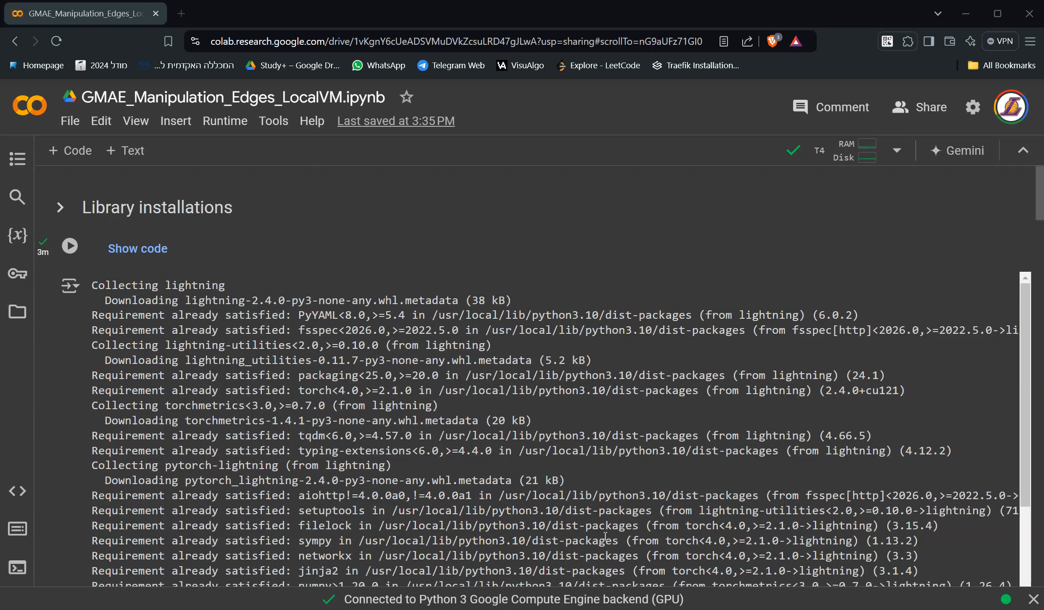
System Demonstration

Slide 19
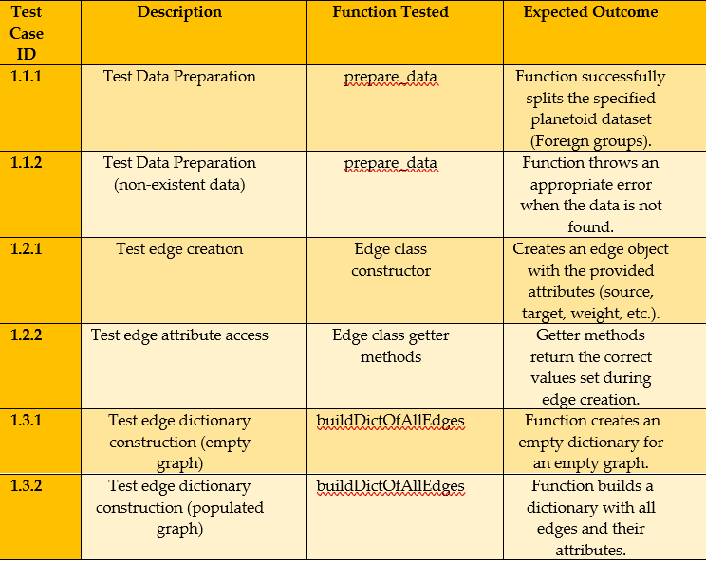
Unit tests

Slide 20
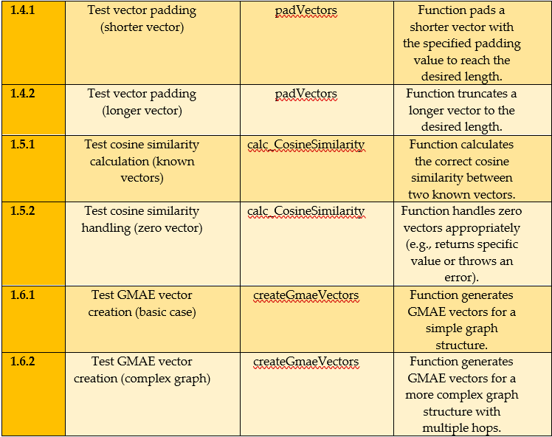
Unit tests

Slide 21

Thanks for listening …

